Slide 1
8 Bit ALU
(Arithmetic Logic Unit)
Smit Shah | 19BCE259

Slide 2
Introduction
ALU is called as the mathematical brain of the computer.
It performs various arithmetic and logical operations
i. Arithmetic - Add, Subtract, Multiply, Divide
ii. Logical - AND, OR, NOR, XOR, NAND, XNOR, Comparison
The Intel 74181 was the most famous ALU that was built in 1970 which was the first complete ALU that fit entirely inside a single chip (handled 4 bits and consisted of 70 logic gates) but it couldn’t multiply or divide.

Slide 3
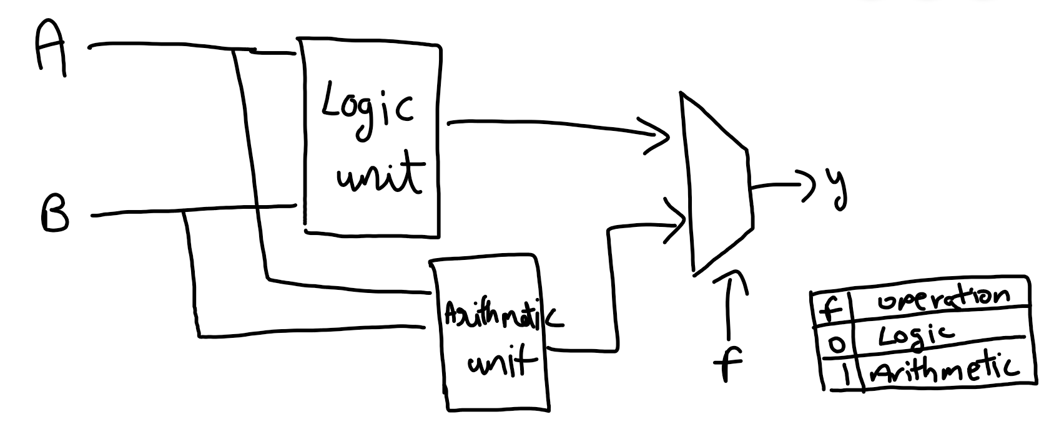
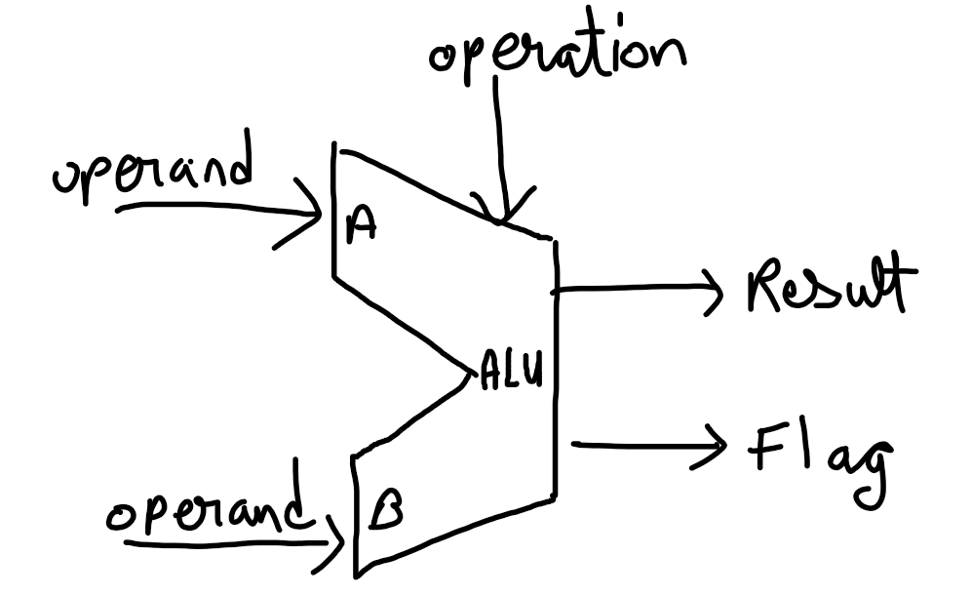
Schematic diagram

Slide 4
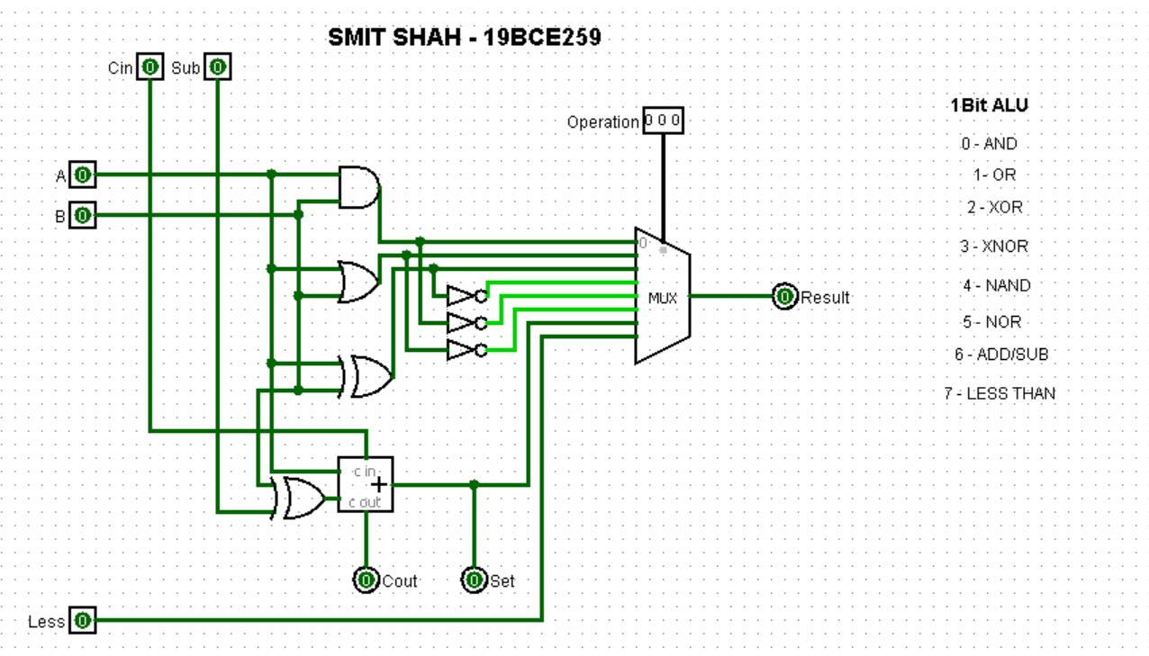
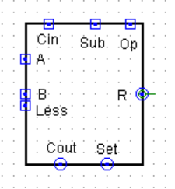
1 Bit ALU

Slide 5
8 Bit ALU
To make a full 8 bit ALU, we started of with a simple 1 bit ALU
Then we took the object of 1 bit ALU, and converted it into a 8 bit ALU using different operation codes.
000 - AND 100 - NAND
001 - OR 101 - NOR
010 - XOR 110 - Add / Sub (for sub set the sub bit)
011 - XNOR 111 - Less than ( set the sub bit)

Slide 6
Thank you!

